Slide 1


Department of Computer Science and Engineering
DEMAND PREDICTION USING AUTOML BASED ENSEMBLE ALGORITHM
Team ID:B21A2425C22 Mohamed Hussain (210701161)
Nathaniel Abishek (210701173)
Dr. Senthil Pandi S, M.Tech., Ph.D.

Slide 2
Problem Statement and Motivation
Traditional demand prediction methods are labor-intensive, requiring significant manual effort for tasks such as feature selection, model building, and hyperparameter tuning.
These methods often demand expert-level knowledge in machine learning, making them difficult for non-experts to implement effectively.
Handling large datasets and complex patterns in the data is a significant challenge for traditional methods, leading to potential inefficiencies and suboptimal predictions.

Slide 3
Problem Statement and Motivation
There is a lack of automation in existing demand prediction pipelines, which results in time-consuming and error-prone processes.
The need arises for a more automated, efficient, and accurate approach to demand prediction that reduces the reliance on manual intervention while maintaining high performance.

Slide 4
Objectives
Automation of Ensemble construction
Diversity and model selection
Dynamic ensemble adaption
Real-world validation
Improved predictive performance
Domain specific availability

Slide 5
Abstract
Integration of AutoML and ensemble techniques enhance demand forecasting by automating essential processes like model selection, data cleaning, and hyperparameter tuning. This approach streamlines the machine-learning pipeline while improving prediction accuracy through the combination of outputs from multiple models. The system provides precise demand estimates, optimizing inventory management and resource allocation in various sectors such as tourism and e commerce.
By automating predictions, businesses can make more informed decisions with high accuracy. Future developments will focus on incorporating real-time data and tailoring AutoML systems to address industry-specific challenges, further improving decision making for organizations.

Slide 6
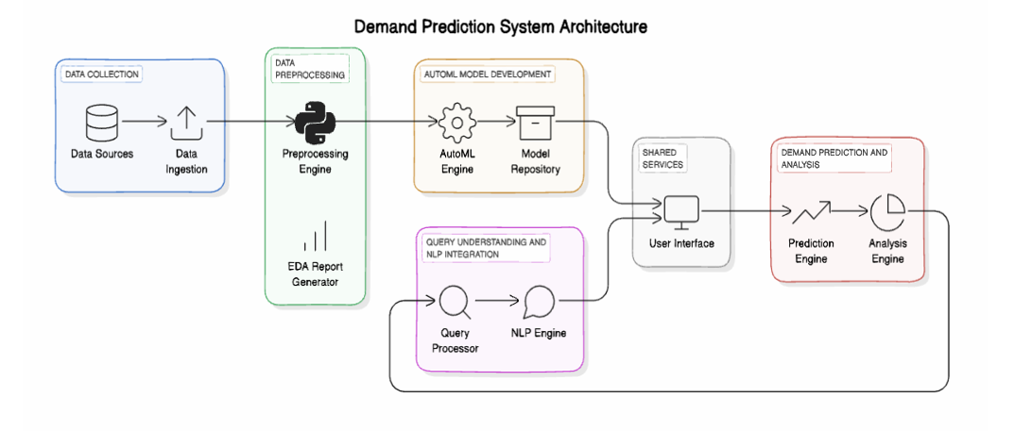
System Architecture

Slide 7
List of Modules
Data Collection and Cleaning
Exploratory Data Analysis
Feature Engineering
AutoML Model Selection and Ensembling
Model Evaluation
Web Application Integration
Reporting and Visualization

Slide 8
Functional Description for Data collection & Cleaning
Data Ingestion: User uploads data set through the UI
Data Validation: Verify data consistency by checking for duplicates, missing values, and inconsistencies.
Data Cleaning: Remove errors, handle null values, and standardize formats.
Preprocessing: Transform raw data into structured formats suitable for analysis, including normalization and feature extraction.

Slide 9
Functional Description for Exploratory Data Analysis
Descriptive Statistics: Summarize data using mean, median, variance, and distributions to understand trends and patterns.
Data Visualization: Use graphs and charts like histograms and scatterplots to explore relationships and outliers.
Correlation Analysis: Identify relationships between variables to select impactful features.
Data Insights: Detect anomalies, trends, and potential challenges for informed preprocessing and modeling decisions.

Slide 10
Functional Description for Feature Engineering
Feature Selection: Identify the most relevant features from the dataset using techniques like correlation and mutual information.
Feature Transformation: Normalize, scale, or encode data to ensure compatibility with machine learning algorithms.
Dimensionality Reduction: Simplify datasets using techniques like PCA to remove redundant or irrelevant features while retaining essential information.

Slide 11
Functional Description for AutoML model selection and Ensembling
Model Selection: Automatically evaluate multiple algorithms to identify the best-performing models based on accuracy, precision, or other metrics.
Hyperparameter Tuning: Optimize model parameters automatically to enhance performance and reduce overfitting.
Ensembling Techniques: Combine top models using methods like bagging, boosting, or stacking to improve robustness and accuracy.

Slide 12
Functional Description for Model Evaluation
Performance Metrics: Evaluate models using metrics like RMSE, MAE, accuracy, precision, recall, and F1-score to assess prediction quality.
Validation Techniques: Use cross-validation and train-test splits to ensure the model generalizes well to unseen data.
Comparative Analysis: Compare model performance to baseline methods and select the most reliable approach for deployment.

Slide 13
Functional Description for Web Application INtegration
Frontend Integration: Uses an intuitive UI for users to upload datasets, configure options, and view demand predictions.
Backend Connectivity: Connect the web application to the prediction system and carry the models using Flask.
Scalability: Ensure the web application supports multiple users and large datasets while maintaining performance and reliability.

Slide 14
Functional Description for Reporting and Visualization
Trend Analysis: Visualize historical and forecasted demand patterns for better decision-making.
Export Options: Provide downloadable formats like PDF or Excel for sharing and offline analysis of results.
Interactive Dashboards: Create dynamic dashboards to display predictions, trends, and key insights using graphs, charts, and tables.

Slide 15
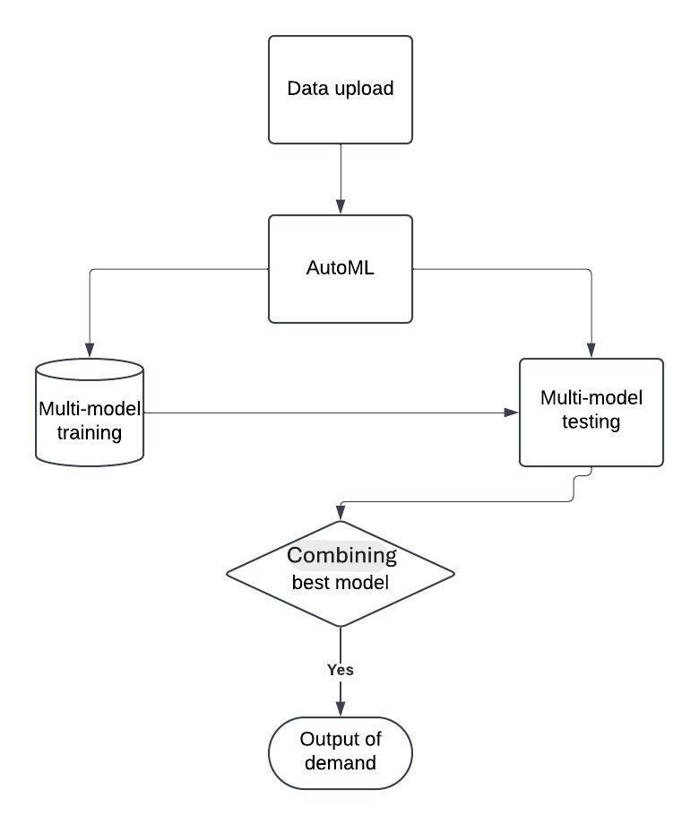
Data Flow Diagram

Slide 16
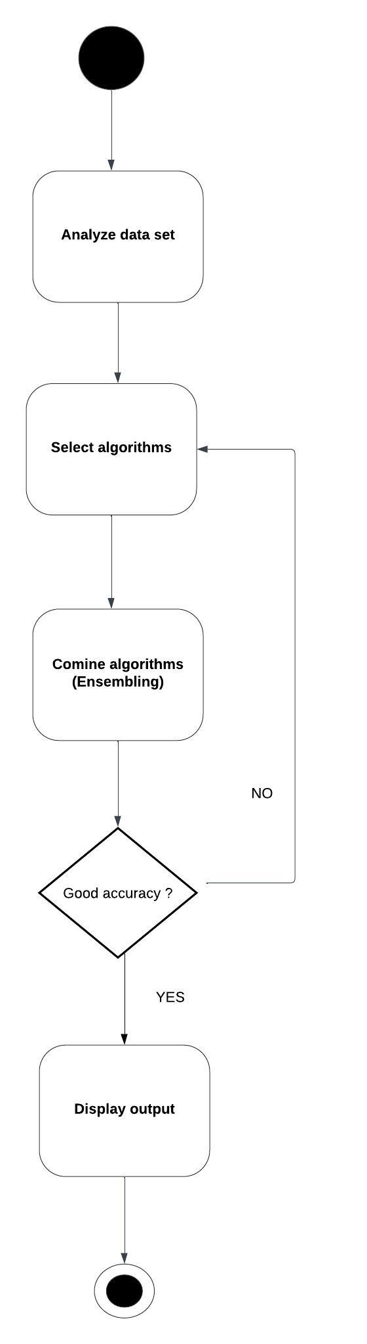
Functional Description for each modules with DFD and Activity Diagram

Slide 17
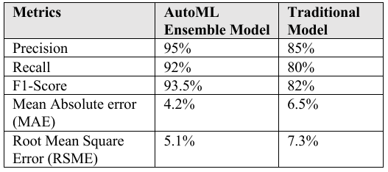
Implementation & Results of First Module
The AutoML-generated ensemble models are expected to deliver an accuracy of around 90-95% for short-term demand forecasts and 85-90% for longer-term predictions. In cases involving seasonal or highly volatile product categories, the system still maintains an accuracy of approximately 80-85%, outperforming many traditional models.

Slide 18
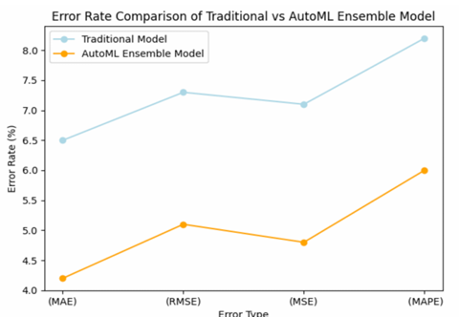
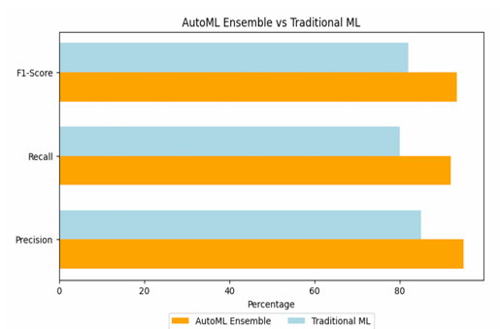
Implementation & Results of First Module

Slide 19
Conclusion & Work for Phase II
In this work, we have demonstrated an effective methodology for demand prediction using AutoML-powered ensemble algorithms. By integrating various traditional models with modern ensemble techniques, our system shows a significant improvement in predictive accuracy for both short-term and long-term forecasts.
The ensemble model consistently outperformed traditional models, achieving up to 93% accuracy in short-term predictions and 88% in long-term scenarios, compared to 80% and 75% from traditional models, respectively.

Slide 20
Conclusion & Work for Phase II
Further optimization - Explore advanced optimization techniques to reduce search space complexity
Broader testing - Validate the framework on high-dimensional, noisy, and imbalanced datasets
New features - Incorporate ensemble diversity metrics for dynamic model selection.
Domain specificity - Collaborate with domain experts to tailor the system for industry-specific challenges

Slide 21
References
[1] S. Mhatre, S. Patil, N. Mishra, V. Mungelwar and H. Patil, "AutoML Based Tourism Prediction and Maximising Revenue," 2024 2nd International Conference on Sustainable Computing and Smart Systems (ICSCSS), Coimbatore, India, 2024, pp. 1193-1202,doi: 10.1109/ICSCSS60660.2024.10625466.
[2] T. Nagarajah and G. Poravi, "A Review on Automated Machine Learning (AutoML) Systems," 2019 IEEE 5th International Conference for Convergence in Technology (I2CT), Bombay, India, 2019, pp. 1-6, doi: 10.1109/I2CT45611.2019.9033810.
[3] Q. Lyu and R. Zhang, "Research on Demand Forecasting Method of Shared Bicycle Based on Ensemble Learning," 2023 International Conference on Image Processing, Computer Vision and Machine Learning (ICICML), Chengdu, China, 2023, pp. 861-865,doi: 10.1109/ICICML60161.2023.10424944.
[4] D. Mallikarachchi, D. Rathnayake, D. Abegunawardana, S. Van-Hoff, D. Kasthurirathna and A. Gamage, "Automated Machine Learning for Prediction of Type 2 Diabetes and Its Major Complications: A Comparative Study," 2023 5th International Conference on Advancements in Computing (ICAC), Colombo, Sri Lanka, 2023, pp. 466-471, doi: 10.1109/ICAC60630.2023.10417572.

Slide 22
References
[5] A. Ghareeb, H. Al-bayaty, Q. Haseeb and M. Zeinalabideen, "Ensemble learning models for short-term electricity demand forecasting," 2020 International Conference on Data Analytics for Business and Industry: Way Towards a Sustainable Economy (ICDABI), Sakheer, Bahrain, 2020, pp. 1-5, doi: 10.1109/ 2020.9325623.
[6] Y. Jin, X. Ye, Q. Ye, T. Wang, J. Cheng and X. Yan, "Demand Forecasting of Online Car-Hailing With Stacking Ensemble Learning Approach and Large Scale Datasets," in IEEE Access, vol. 8, pp. 199513-199522, 2020, doi: 10.1109/ACCESS.2020.3034355.
[7] V. E. Kovalevsky and N. A. Zhukova, "Building a Model for Time Series Forecasting using AutoML Methods," 2024 XXVII International Conference on Soft Computing and Measurements (SCM), Saint Petersburg, Russian Federation, 2024, pp. 308-311, doi: 10.1109/SCM62608.2024.10554133.
[8] H. -A. -D. Cap, T. -H. Do, D. S. Lakew and S. Cho, "Building a Time-Series Forecast Model with Automated Machine Learning for Heart Rate Forecasting Problem," 2022 13th International Conference on Information and Communication Technology Convergence (ICTC), Jeju Island, Korea, Republic of, 2022, pp. 1097-1100, doi: 10.1109/ICTC55196.2022.9952797.

Slide 23
References
[9] I. Met, A. Erkoç and S. E. Seker, "Performance, Efficiency, and Target Setting for Bank Branches: Time Series With Automated Machine Learning," in IEEE Access, vol. 11, pp. 1000-1010, 2023,doi: 10.1109/ACCESS.2022.3233529.
[10] G. Stamatescu, R. Plamanescu and M. Albu, "Leveraging Anomaly Detection and AutoML for Modelling Residential Measurement Power Traces," 2023 IEEE 13th International Workshop on Applied Measurements for Power Systems (AMPS), Bern, Switzerland, 2023, pp. 1-5, doi: 10.1109/AMPS59207.2023.10297201.
[11] H. Iftikhar, S. Mancha Gonzales, J. Zywiołek and J. L. López-Gonzales, "Electricity Demand Forecasting Using a Novel Time Series Ensemble Technique," in IEEE Access, vol. 12, pp. 88963-88975, 2024,doi: 10.1109/ACCESS.2024.3419551.
[12] P. Kumar, U. L. Maneesh and G. Mano Sanjay (2024), "Optimizing Loan Approval Decisions: Harnessing Ensemble Learning for Credit Scoring," 2024 International Conference on Advances in Computing, Communication and Applied Informatics (ACCAI), Chennai, India, 2024, pp. 1-4, doi: 10.1109/ACCAI61061.2024.10602097.

Slide 24
References
[13] Y. Zhang, H. Zhu, Y. Wang and T. Li, "Demand Forecasting: From Machine Learning to Ensemble Learning," 2022 IEEE Conference on Telecommunications, Optics and Computer Science (TOCS), Dalian, China, 2022, pp. 461-466, doi: 10.1109/TOCS56154.2022.10015992.
[14] D. Hulak and G. Taylor, "Investigating an Ensemble of ARIMA Models for Accurate Short-Term Electricity Demand Forecasting," 2023 58th International Universities Power Engineering Conference (UPEC), Dublin, Ireland, 2023, pp. 1-6, doi: 10.1109/UPEC57427.2023.10294946.
[15] P. Naik, M. Dalponte and L. Bruzzone, "Automated Machine Learning Driven Stacked Ensemble Modeling for Forest Aboveground Biomass Prediction Using Multitemporal Sentinel-2 Data," in IEEE Journal of Selected Topics in Applied Earth Observations and Remote Sensing, vol. 16, pp. 3442-3454, 2023, doi: 10.1109/JSTARS.2022.3232583.
[16] A. Garg and A. Chaudhary, "Analysis of IPL Auction Dataset Using Explainable Machine Learning with Lime and H2O AutoML," 2023 4th International Conference on Intelligent Engineering and Management (ICIEM), London, United Kingdom, 2023, pp. 1-4, doi: 10.1109/ICIEM59.2023.10167124.

Slide 25
References
[17]. Sathvik, S. P. A. Gollapalli, S. N. Sadhwani and V. A. Punagin, "Brain Tumor Diagnosis and Classification based on AutoML and Traditional Analysis," 2022 IEEE Global Conference on Computing, Power and Communication Technologies (GlobConPT), New Delhi, India, 2022, pp. 1-7, doi: 10.1109/GlobConPT57482.2022.993814.
[18] S. Talapaneni, C. S. Kota, N. Yalagala, R. Nunna and R. Mothukuri, "Enhancing Heart Disease Prediction and Analysis: An Efficient Voting Ensemble model," 2024 International Conference on Communication, Computer Sciences and Engineering (IC3SE), Gautam Buddha Nagar, India, 2024, pp. 156-160, doi: 10.1109/IC3SE62002.2024.10593602.
[19] K. Han, T. T. Nguyen, V. A. Vu, A. W. -C. Liew, T. Dang and T. T. Nguyen, "VISTA: A Variable Length Genetic Algorithm and LSTM-Based Surrogate Assisted Ensemble Selection algorithm in Multiple Layers Ensemble System," 2024 IEEE Congress on Evolutionary Computation (CEC), Yokohama, Japan, 2024, pp. 1-9, doi: 10.1109/CEC60901.2024.10612029.
[20] P. Kumar, K. N. Manisha and M. Nivetha (2024), "Market Basket Analysis for Retail Sales Optimization (2024)," 2024 Second International Conference on Emerging Trends in Information Technology and Engineering (ICETITE), Vellore, India, pp. 1-7, doi: 10.1109/ic-ETITE58242.2024.10493283.

Slide 26
Paper Publication Status
Waiting for approval….

Slide 27
Thank You

